Slide 1
Vision Processing
Jim Wright
STEALTH 4089

Slide 2
Ways people are doing this
On board vision processing
Raspberry PI co-processor
Kangaroo Board
Nvidia Jetson TX1, TK1, TX2

Slide 3
On Board
Simplest to get working
Slow your processor down
Simplest to show on the dash board

Slide 4
On Board
Simplest to get working
Slow your processor down
Simplest to show on the dash board

Slide 5
Just getting the video on the Dashboard
public void robotInit() {
CameraServer.getInstance().startAutomaticCapture();
}

Slide 6
On Board
In InitRobot create and start a thread.
This runs all the time.
new Thread(() -> {
}).start();

Slide 7
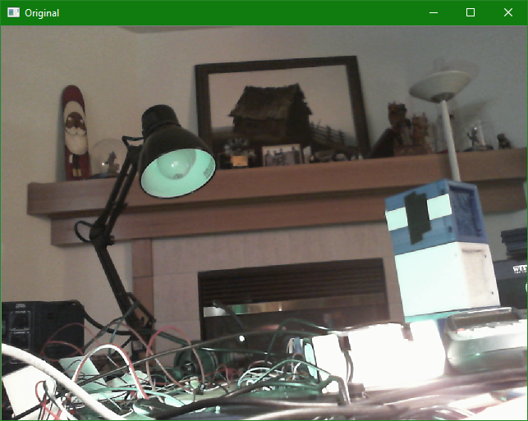
An interuption
Vision Processing is not a problem on getting the camera correct, it’s getting the lighting correct.

Slide 8
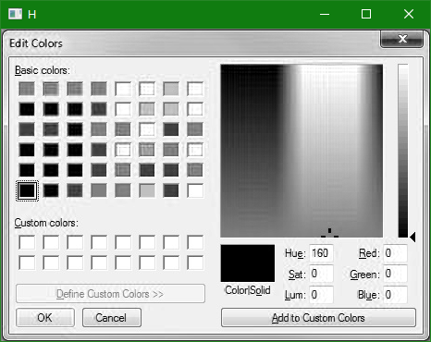
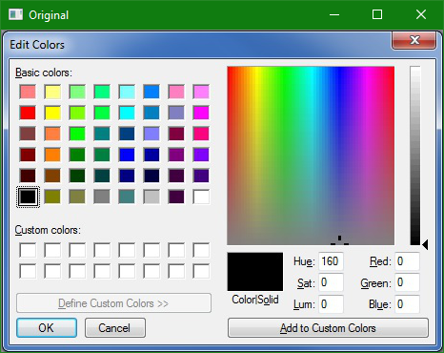
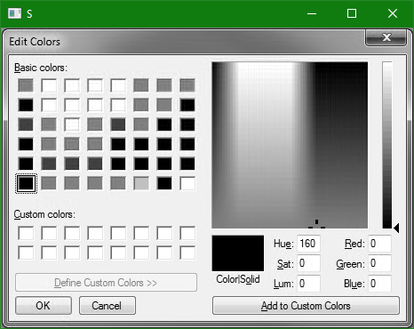
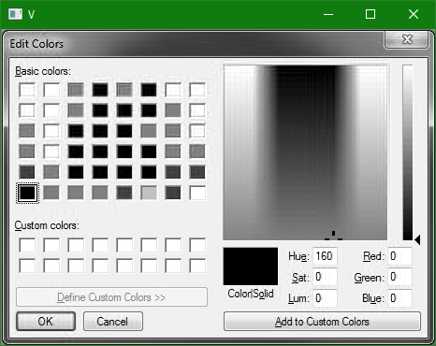
Splitting the Image using RGB

Slide 9
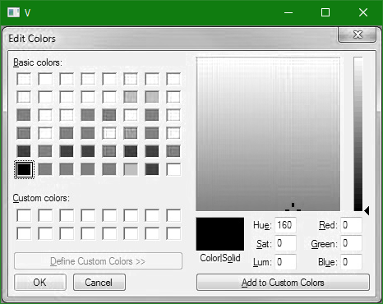
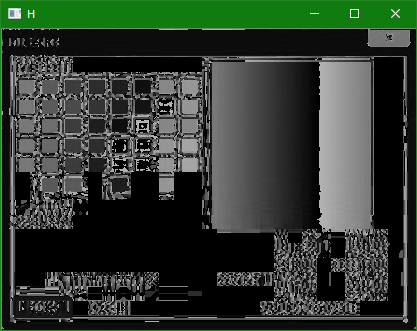
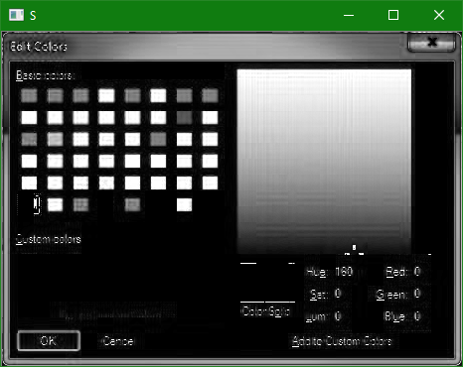
Splitting the Image using HSV

Slide 10
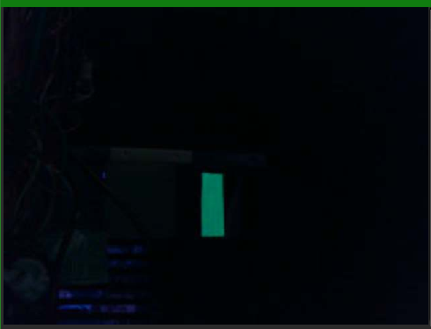
Camera exposure set really low, with out and with Green LED

Slide 11
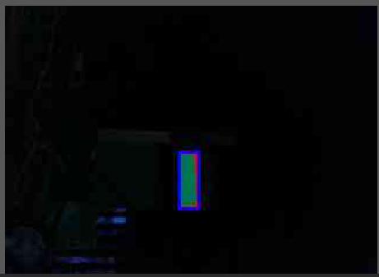
Finding the blobs and where is the biggest blob

Slide 12
In the thread
Set up camera
Set up outputStream
UsbCamera camera = CameraServer.getInstance().startAutomaticCapture();
camera.setResolution(320, 240);
camera.setExposureManual(2);
camera.setBrightness(2);
camera.setWhiteBalanceManual(0);
CvSink cvSink = CameraServer.getInstance().getVideo();
CvSource outputStream = CameraServer.getInstance().putVideo("Orig", 320, 240);

Slide 13
Get the frame
Get a frame and convert it to Gray Scale
Converting to HSV is to much for the RoboRio to handle
cvSink.grabFrame(imgOriginal);
Imgproc.cvtColor(imgOriginal, imgHSV, Imgproc.COLOR_BGR2GRAY);
Imgproc.threshold(imgHSV, imgThresholded, 30, 255, Imgproc.THRESH_BINARY);

Slide 14
Morphing
Morphing gets rid of noise
//morphological opening (remove small objects from the foreground)
Imgproc.erode(imgThresholded, imgThresholded,
Imgproc.getStructuringElement(Imgproc.MORPH_ELLIPSE, new Size(morphSize, morphSize)));
Imgproc.dilate(imgThresholded, imgThresholded,
Imgproc.getStructuringElement(Imgproc.MORPH_ELLIPSE, new Size(morphSize, morphSize)));
//morphological closing (fill small holes in the foreground)
Imgproc.dilate(imgThresholded, imgThresholded,
Imgproc.getStructuringElement(Imgproc.MORPH_ELLIPSE, new Size(morphSize, morphSize)));
Imgproc.erode(imgThresholded, imgThresholded,
Imgproc.getStructuringElement(Imgproc.MORPH_ELLIPSE, new Size(morphSize, morphSize)));

Slide 15


Morphing Erosion
Erosion is taking a big blob and making it a small blob

Slide 16

Morphing Dilation
Dilation is taking a blob and making it a big blob

Slide 17

Morphing Opening
Remove the salt
Erosion followed by dilation

Slide 18

Morphing closing
Remove the pepper
Dilation followed by Erosion

Slide 19
Finding the blobs
Find all the blobs
It creates a list of blobs
Destructive to the image
imgThresholded.copyTo(imgThresholdedCopy);
List<MatOfPoint> contours = new Vector<MatOfPoint>();
Mat hierarchy = new Mat();
Imgproc.findContours(imgThresholdedCopy, contours, hierarchy,
Imgproc.RETR_TREE, Imgproc.CHAIN_APPROX_SIMPLE, new Point(0, 0));

Slide 20
Find the two biggest blobs
for (int i = 0; i< contours.size(); i++) {
double area = Imgproc.contourArea(contours.get(i));
if (area > largestArea1) {
largestArea2 = largestArea1;
largestCont2 = largestCont1;
rct2 = rct1;
largestArea1 = area;
largestCont1 = i;
rct1 = Imgproc.boundingRect(contours.get(largestCont1)); }
else {
if (area > largestArea2) {
largestArea2 = area;
largestCont2 = i;
rct2 = Imgproc.boundingRect(contours.get(largestCont2));
} } }

Slide 21
Draw the blob and bounding rec
MatOfPoint2f mat = new MatOfPoint2f( contours.get(largestCont1).toArray() );
Imgproc.approxPolyDP(mat, mat, 3, true);
Imgproc.drawContours(imgOriginal, contours, largestCont1, color, 2, 8, hierarchy, 0, new Point());
color = new Scalar(255, 0, 0);
Imgproc.rectangle(imgOriginal, rct1.tl() ,rct1.br() , color, 2);

Slide 22
Draw the blob and bounding rec
int cx = ((rct1.x+(rct1.x+rct1.width))/2 + (rct2.x+(rct2.x+rct2.width))/2)/2;
int cy = ((rct1.y+(rct1.y+rct1.height))/2 + (rct2.y+(rct2.y+rct2.height))/2)/2;
color = new Scalar(0, 255, 0);
Imgproc.circle(imgOriginal, new Point(cx,cy), 4, color);
System.out.println(cx+" "+cy+" "+
rct1.x+" "+rct1.y+" "+ rct1.width+" "+rct1.height+" "+
rct2.x+" "+rct2.y+" "+ rct2.width+" "+rct2.height+" ");

Slide 23
OpenCV
Open CV is the base library for this code.
It is ported to every platform we use.
C++ is the native language.
If you develop on Windows 10, you can move very easy to Raspberry PI, or Jetsen.

